Slide 1
Project 3: Cars4U (Supervised Learning – Foundations)
Data Science and Business Analytics
Krithika Srinivasan

Slide 2
Objectives
Explore and visualize the dataset.
Build a linear regression model to predict the prices of used cars.
Generate a set of insights and recommendations that will help the business.

Slide 3
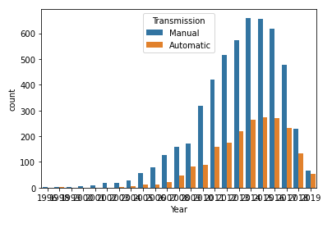
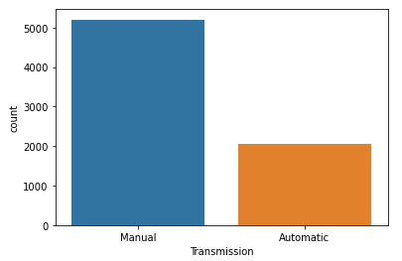
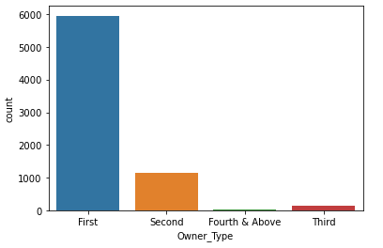
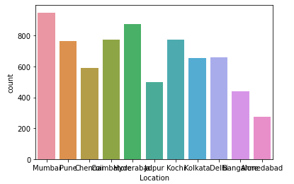
Exploratory Data Analysis (Univariate)
Average price of used cars sorted by order of most expensive to least expensive location
Average price of automatic transmission is higher than that of manual
Electric and Diesel cars are more expensive than other fuel types on average
Cars that have been owned only by one party are more expensive on average
Most cars available in Mumbai
Most cars have been owned by one party

Slide 4
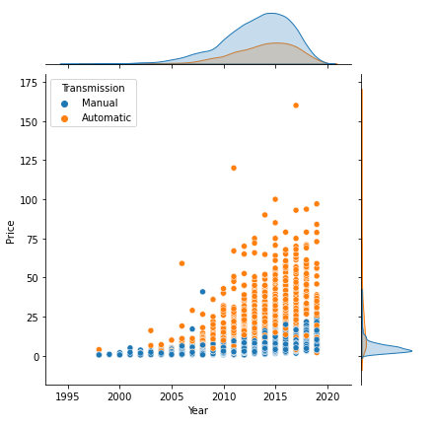
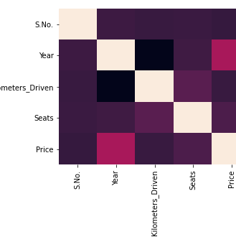
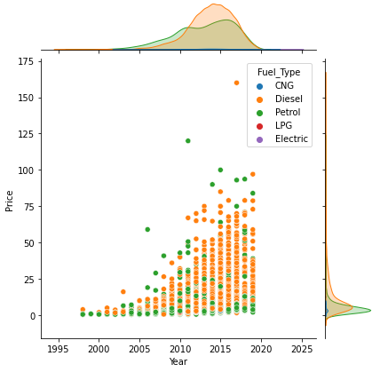
Bivariate Data Analysis
Some correlation between year and price
No evidence of strong correlation between any other columns with Price

Slide 5
Data Preprocessing Steps
Removing suffixes from values in columns- Mileage, Engine, Power, New Price
Converting New Price to the right units for all values
Treating missing values
Encoding categorical columns- Fuel Type, Transmission, Owner Type, Location
Outlier Detection and Treatment
Variable Scaling and Feature Selection

Slide 6
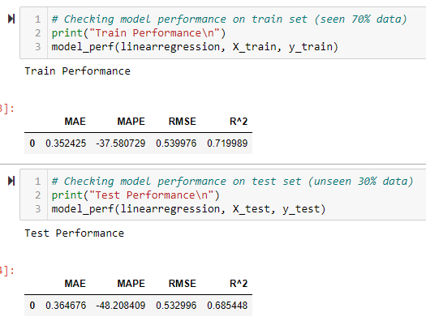
Model Building- Linear Regression
Built the model
Previous model seemed to have better error metrics
There is room for improvement – need to fine tune the model through iterations

Slide 7
Recommendations
Having some better data quality might help make the model prediction better (Example: New_Price column)
Could process the Name column to determine model of the car
Acquire more automatic cars as their price is higher
Acquire more diesel fuel type cars as their price is higher

